Slide 1
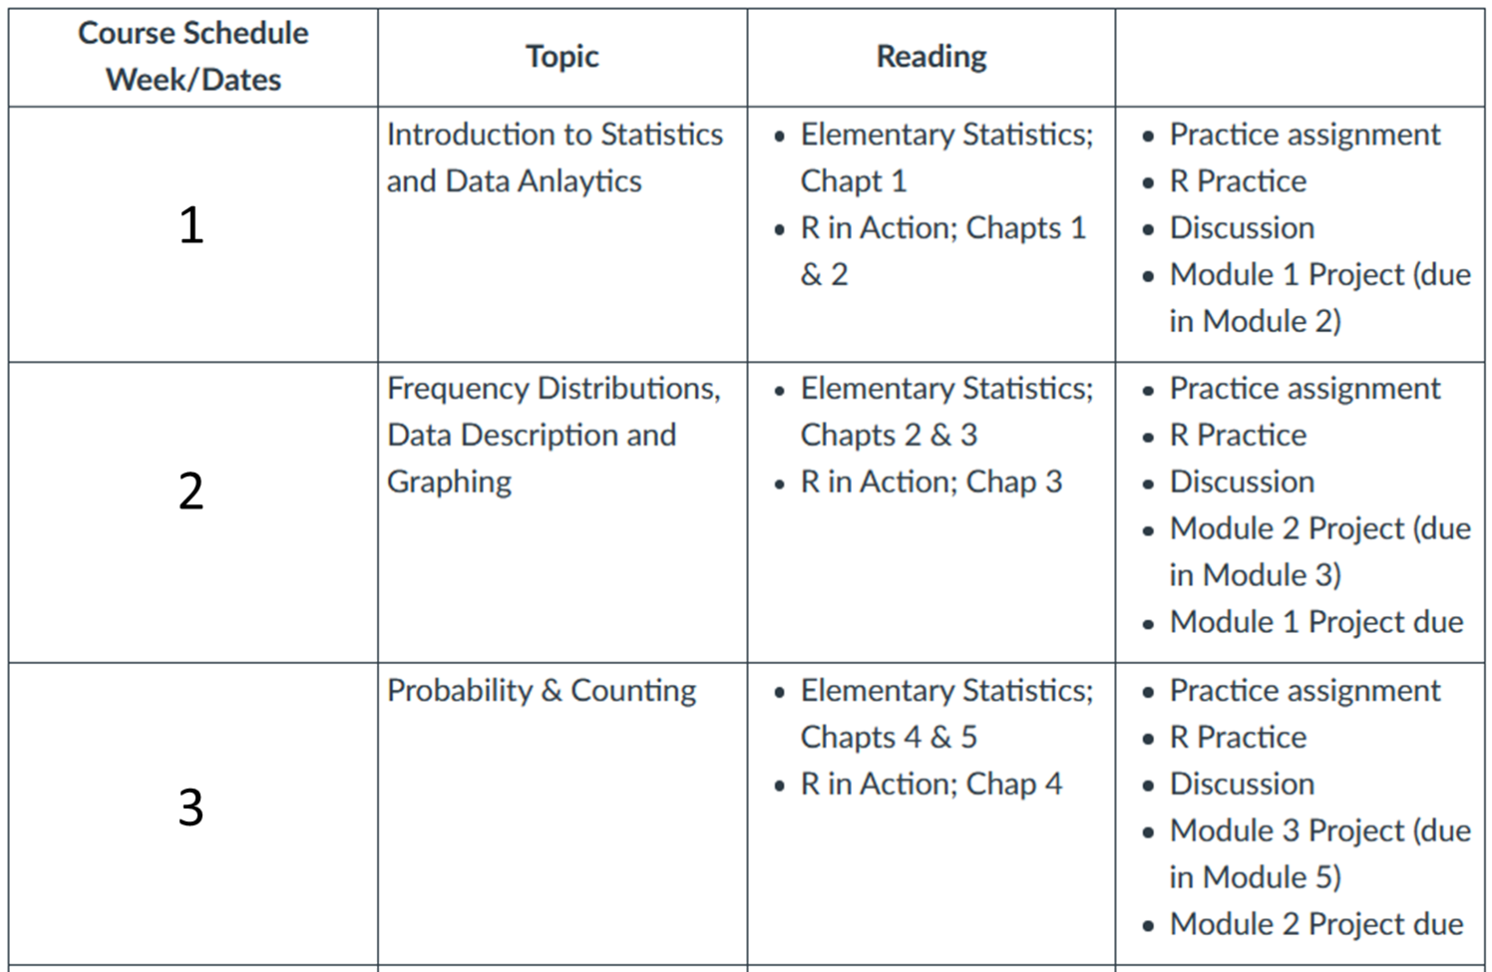
AYL6000 Introduction to Data Analytics

Slide 2
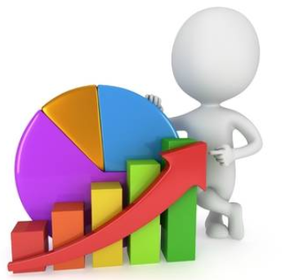
Statistics
Science of collecting and analyzing numerical data
Branch of mathematics dealing with the collection, analysis, interpretation, and presentation of masses of numerical data.
Merriam-Webster, Pub.
It is the science of data; that is, collecting, organizing, summarizing, and analyzing data to finally draw conclusions.
Probability is the most important concept in modern science, especially as nobody has the slightest notion what it means.

Slide 3
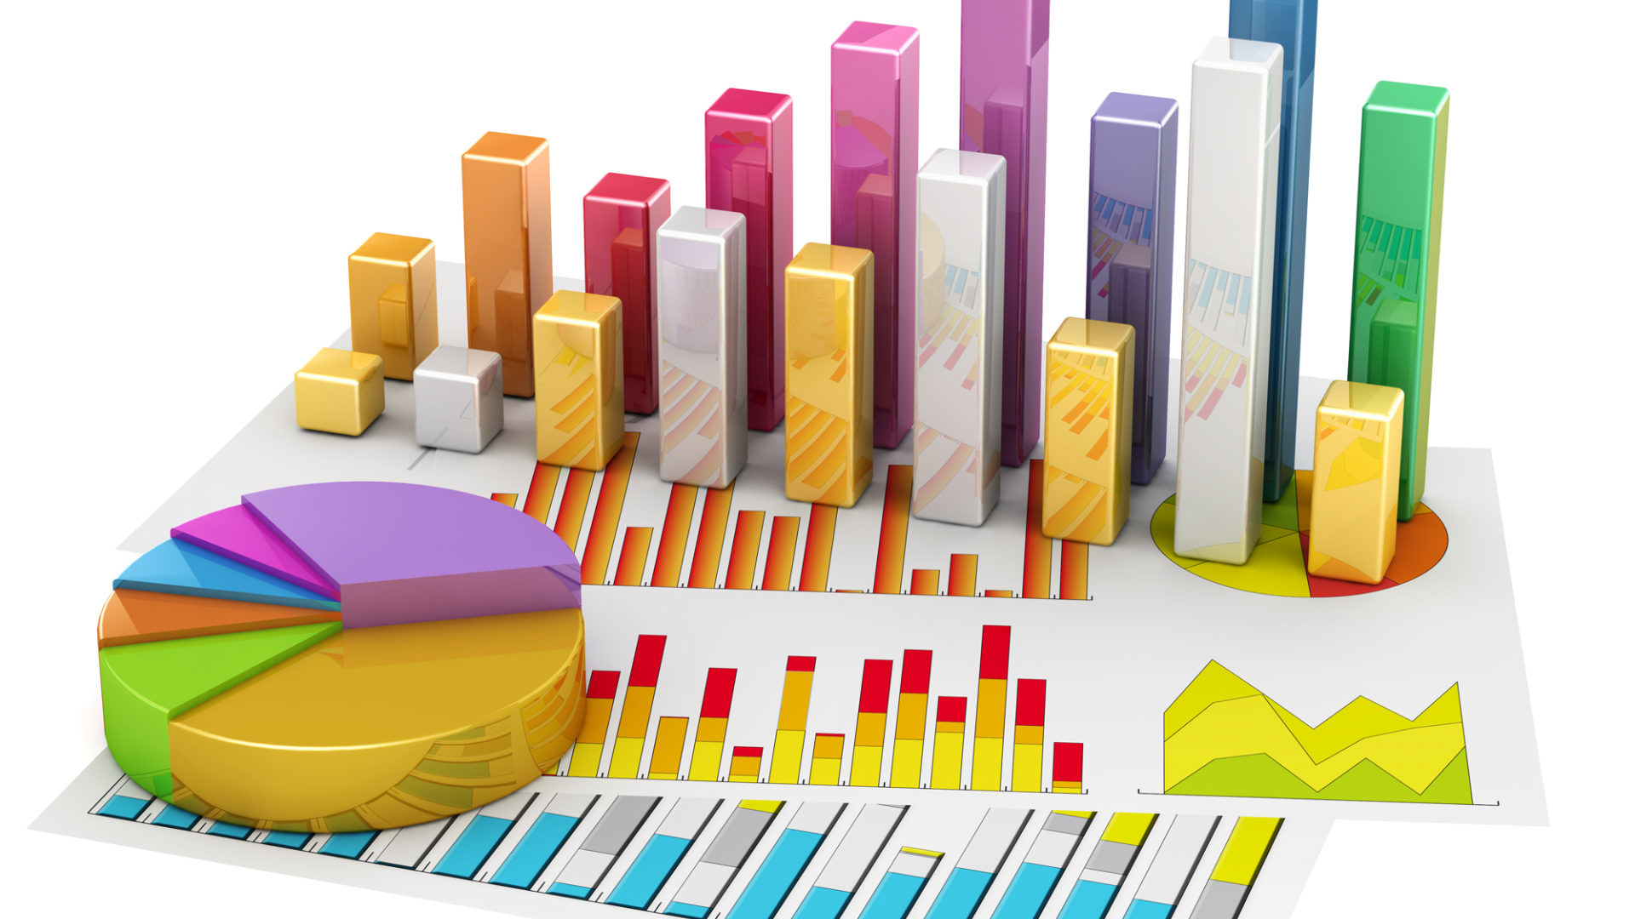
Statistics
Statistics is concerned with the development of methods and their applications for collecting, analyzing and interpreting quantitative data in such a way that the reliability of a conclusion based on data may be evaluated objectively by means of probability statements.
Sahoo, 2013
Probability theory is used to evaluate the reliability of conclusions and inferences based on data. Thus, probability theory is fundamental to mathematical statistics.
Sahoo, 2013

Slide 4

Presentation
Conclusions/
Interpretation
Data Collection
Statistics
Organization
Analysis

Slide 5
Statistics is used in almost all fields of human endeavor.
Presentation
Conclusions/
Interpretation
Data Collection
Statistics
Organization
Analysis

Slide 6

Can you imagine the steps before data collection?
Presentation
Conclusions/
Interpretation
Data Collection
Statistics
Organization
Analysis

Slide 7
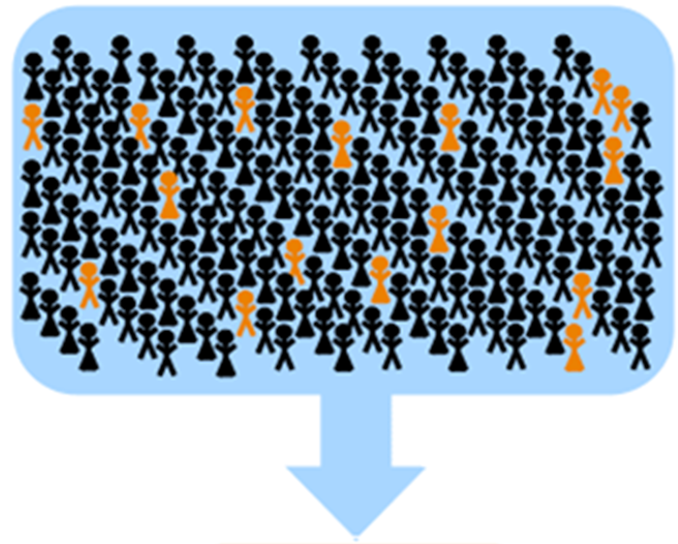
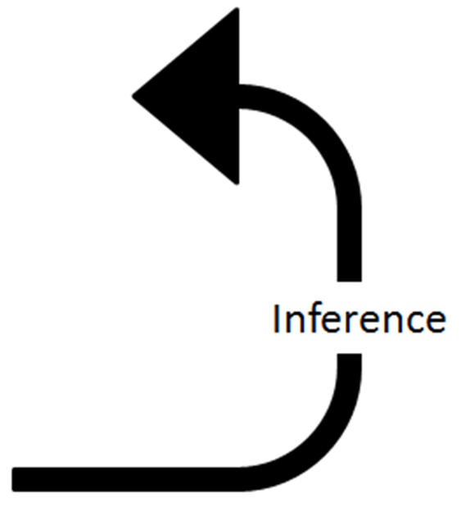
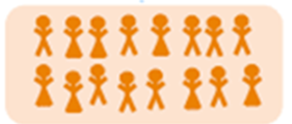
Population
Sampling
Sample

Slide 8
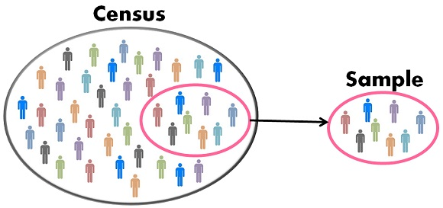

Slide 9
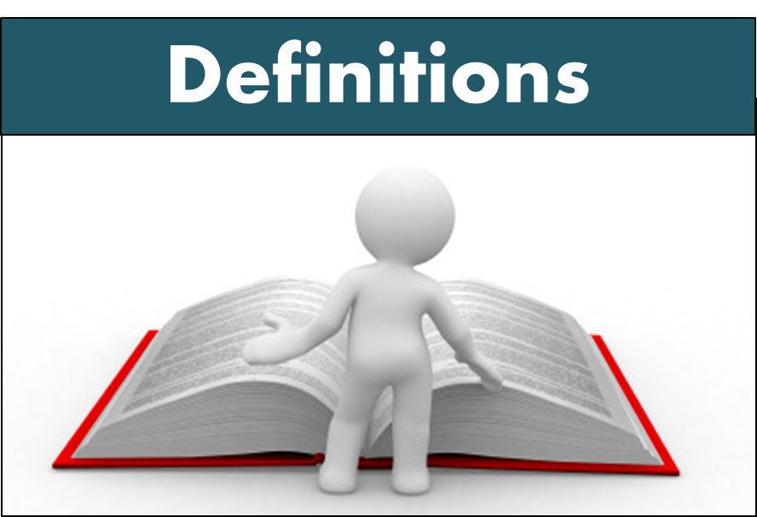
Population
Consists of all the elements or subjects under study, it comprises the entire pool from which a statistical sample is drawn.
Sample
A subset of elements from the population, which has been selected for the study. The number of elements in a sample is denoted by n. Sampling: Random vs stratified
Variable
A characteristic of a population, which is of interest. A variable may be quantitative or qualitative.
Statistical Estimation
A statistical estimate uses measurements from a sample to estimate characteristics of the population.

Slide 10
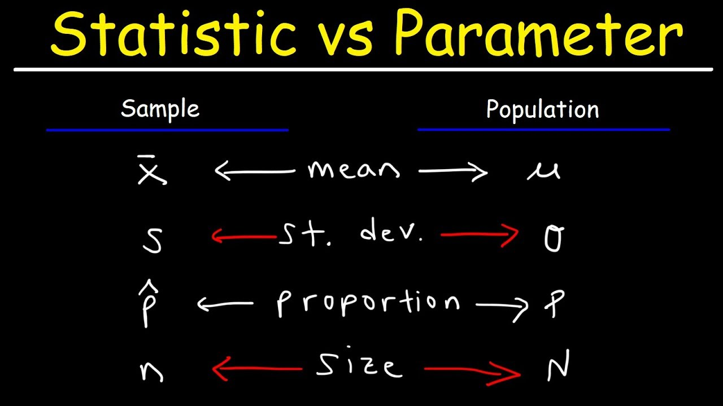
Parameters
Numbers that summarize data for an entire population.
Statistics
Numbers that summarize data from a sample.

Slide 11
Types of Statistics
There are two main types of statistics:
Descriptive statistics:
Used to describe a set of data graphically or numerically
2. Inferential statistics:
It uses random samples in order to gain insight about the population from which those samples were selected.

Slide 12
1. Descriptive Statistics
It describes a set of data, graphically or numerically.
It is a quantitative description of the nature of the data.
Every scientific publication and data presentation requires descriptive statistics.
How many data point did you collect?
How big is your data set?
Three important data information
Where is the center of your data?
How spread is your data?

Slide 13
1. Descriptive Statistics
n
the value
Always indicate how many observations or data points are in your data set.
The subjects you collect are random, but not the amount of data you collect, it has to be planed and with a purpose. It has to be enough to truly represent the nature of the population under study.

Slide 14
1. Descriptive Statistics
the measure of central tendency
A set of summary statistic values that represents the center point of a dataset. These measures indicate where most values in a distribution fall and are also referred to as the central location of a distribution.
Mean
The tree most common are:
Median
Mode

Slide 15
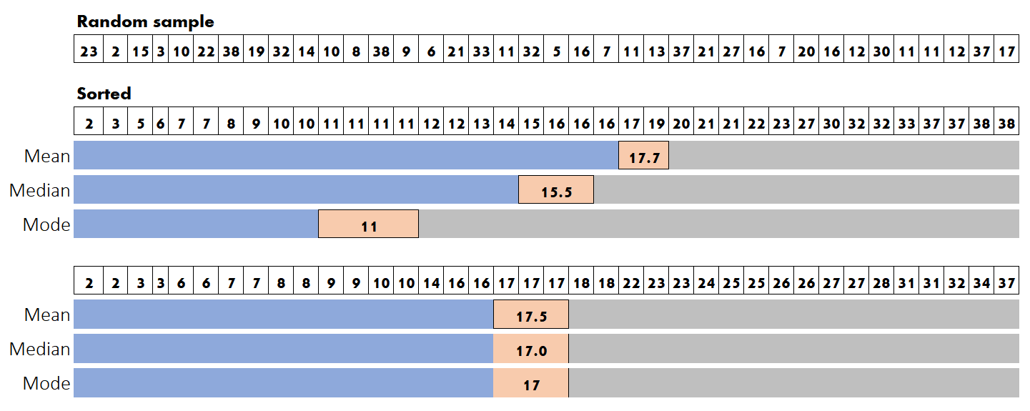
1. Descriptive Statistics
the measure of central tendency

Slide 16
1. Descriptive Statistics
the measure of central tendency

Slide 17
1. Descriptive Statistics
the measure of central tendency

Slide 18
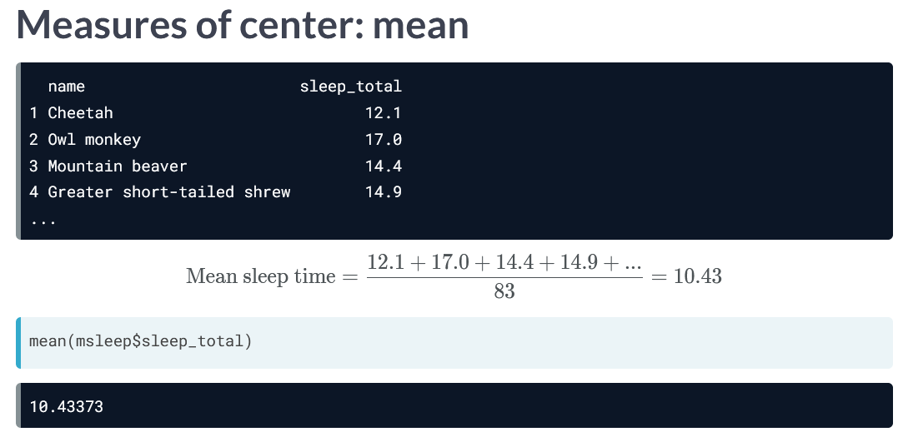

Slide 19
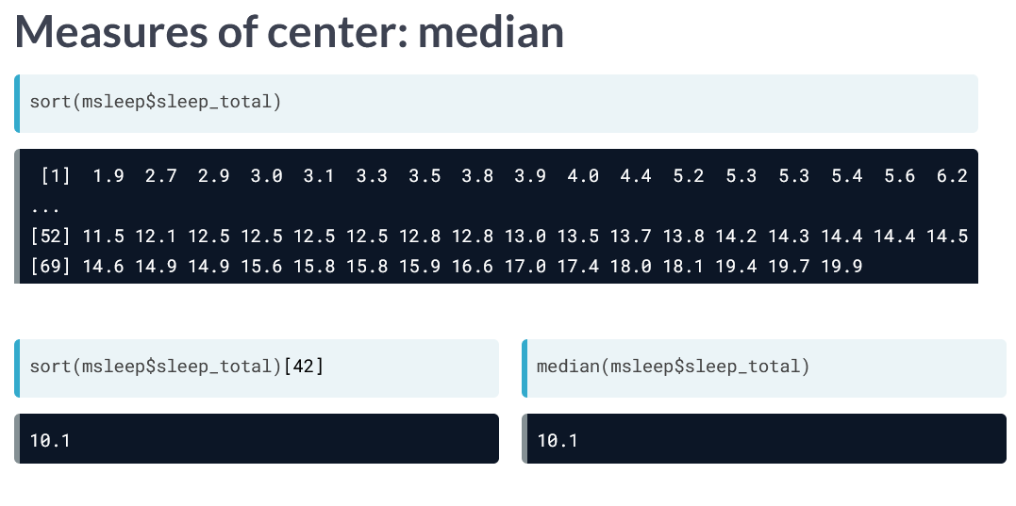

Slide 20

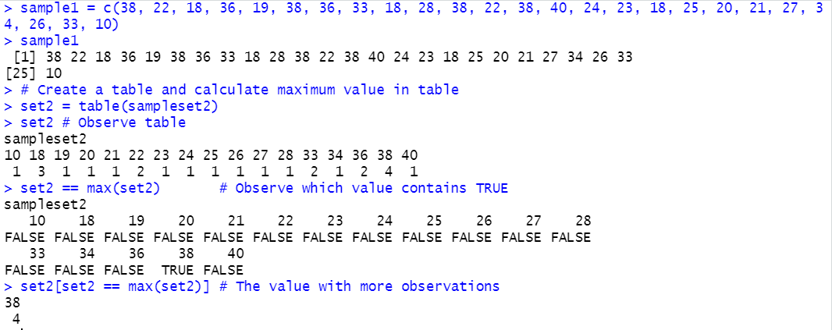
The mode is 38 with a frequency of 4

Slide 21
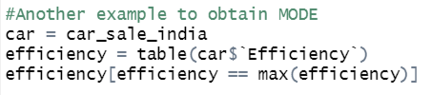
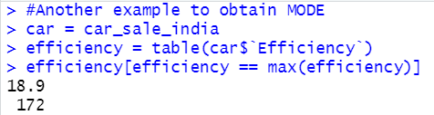
The mode is 18.9 with a frequency of 172

Slide 22
1. Descriptive Statistics
the measure of dispersion
It indicates the variability and extension of the distribution.
Variance
The tree most common are:
Standard deviation
Interquartile range

Slide 23
1. Descriptive Statistics
the measure of dispersion
Variance: measurement of the spread between numbers in a data set, from the center and from each other.
Standard deviation: measures the dispersion of a dataset relative to its mean and is calculated as the square root of the variance.
The tree most common are:
Interquartile range: division of observations into four defined intervals based on the values of the data and how they compare to the entire set of observations

Slide 24
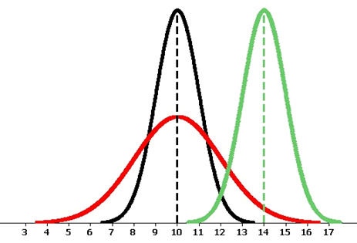
Descriptive statistics:
Numerical descriptions of center of the data:
Mean
Median
Weighted mean
Mode
Numerical descriptions of the variability/spread/dispersion of the data:
Standard deviation
Range
Variance
Numerical descriptions of locations:
Percentile ranking
Z-score
Numerical descriptions of the shape of the distributions:
Kurtosis
Skewness

Slide 25
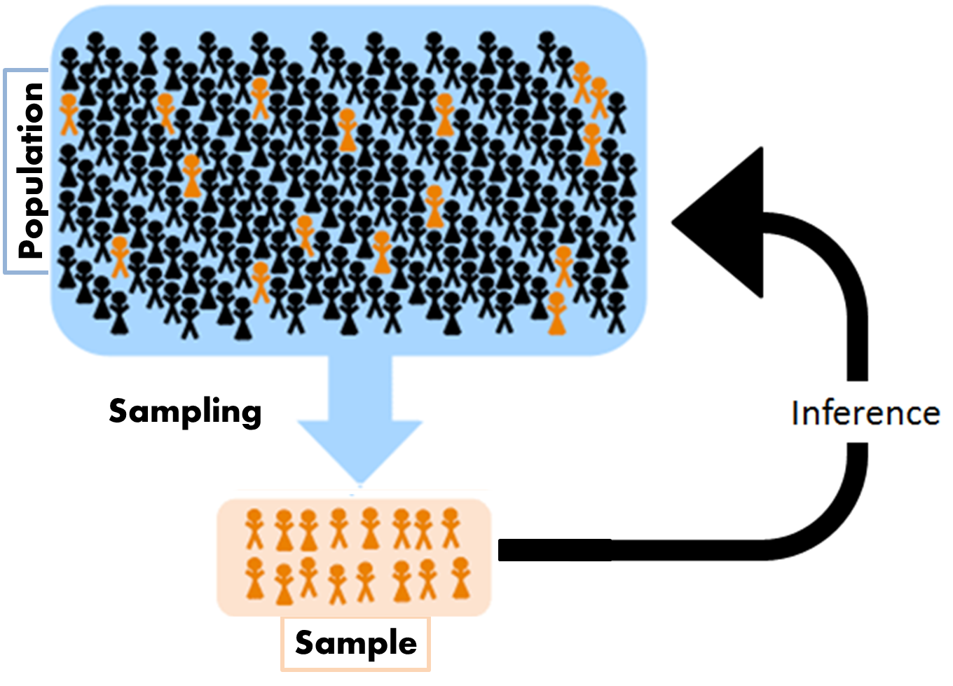
2. Inferential Statistics
Uses one or more random samples in order to gain insight about the population from which those samples were selected.
One or more parameters of a population.
Methods of inferential statistics:
(a) Constructing Confidence Intervals: This is to estimate a population parameter to within two limits: a lower limit and an upper limit
(b) Performing Hypothesis Testing: This is to verify or to reject hypotheses or claims
(c) Modeling or Testing Relationships between Data sets

Slide 26
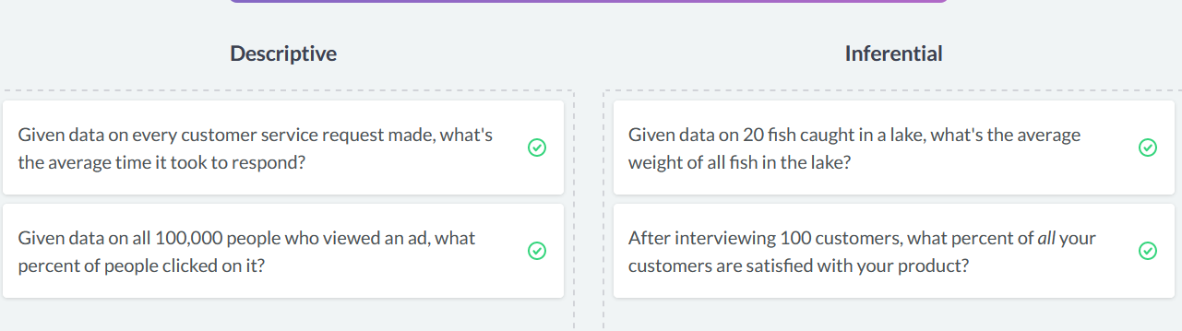

Align the correct statistics type
Descriptive statistics
Inferential statistics

Slide 27
Types of data
1. Categorical (Qualitative)
(a) Nominal: According to Name / Examples: Data containing names, genders, races, etc.
(b) Ordinal: According to Order / Examples: Data containing ranks, data that has been organized alphabetically, etc.
2. Numerical (Quantitative)
(a) Discrete: Measurements take a countable set of isolated values. They cannot assume values in between two given values of the variable.
For example, the number of chairs, the number of patients, the number of accidents, etc., are all examples of discrete data.
(b) Continuous: Measurements can take any real value within a certain range. For example, the amount of rainfall in Charlotte in January during the last 30 years or the amount of customer waiting times at a local bank are examples of continuous data sets.

Slide 28
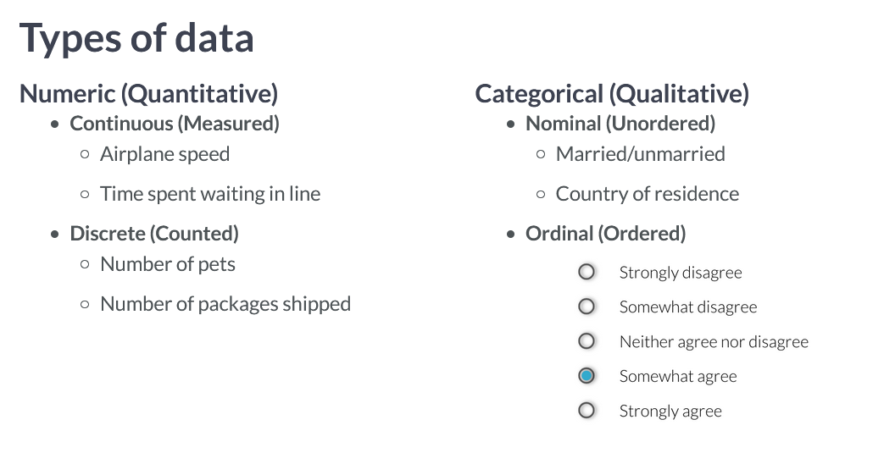
Types of data

Slide 29
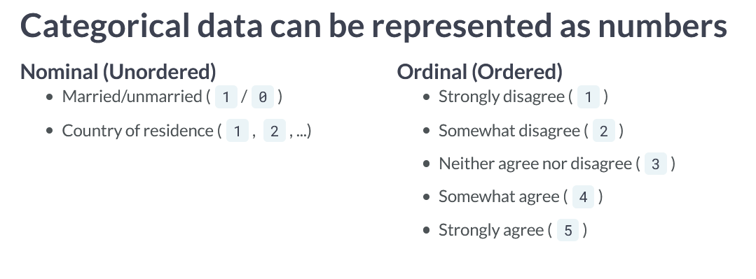
Types of data

Slide 30
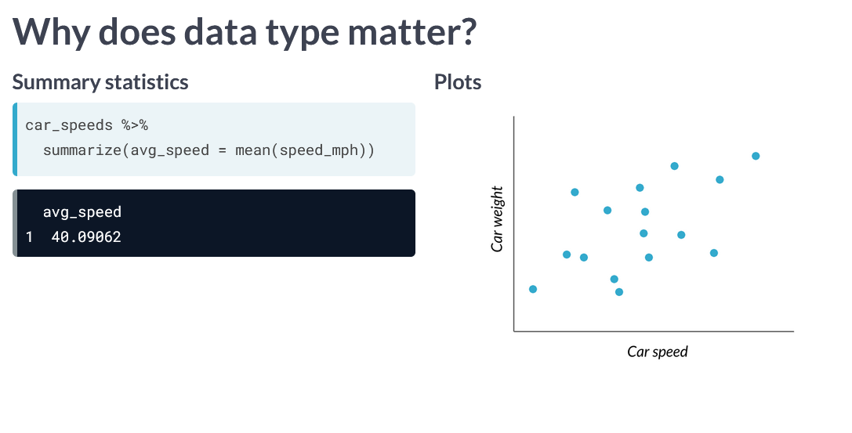
Numeric continuous

Slide 31
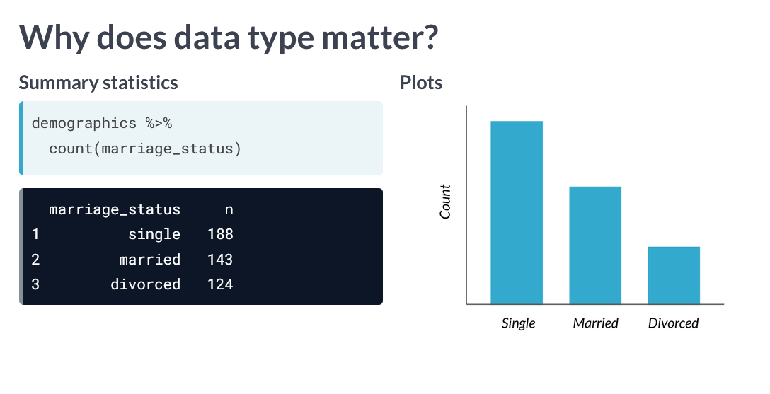
Categorical nominal

Slide 32
Align the correct data type
Number of clicks on an ad
Continuous numeric
Kilowatts of electricity used
Brand of a product
Discrete numeric
Postal code
Categorical
Air temperature
Number of items in stock

Slide 33

How many variables can you imagine from a small sample of people?

Slide 34

Data collection and sampling techniques
We use samples to collect data and information about a particular variable from a large population.
Telephone survey
Main questionnaire
Personal interview
Record analysis
Direct observation
Each method has its pro and cons. A person must be careful to avoid bias on the data collection process. For this purpose, every subject in the population must have the same chance to be selected in the sampling process.
The four basic sampling methods:
Random
Systematic
Stratified
Cluster

Slide 35










Random Sampling

Slide 36
Random Sampling
1
4
2
10
14
3
11
12
15
8
13
#
9
5
7
16
6
19
20
#
#
17
#
#
18
#
#
#
#
#
#
#
#
#
#
#
#
#
#
#
#
#
#
#
#
#
#
#
#
#
#
#
#
#
#
#
Provide a number to each member and using a random number generator (computer or calculator), or placing numbers in a bowl, select the number of samples needed.

Slide 37
Systematic Sampling
Each 5: The first subject is selected by random from the first 5.
3
8
13
18
Each 4: The first subject is selected by random from the first 4.
2
6
10
14
18
This can be used if you are selecting records from a data book.
Keep in mind the size of your population to sample, divide it by the number of samples needed, then that will be your interval.
E.g., population N = 150, samples needed n= 25, interval 150 / 25 = 6.

Slide 38
Stratified Sampling

Slide 39
Stratified Sampling
Separate the population in groups based on a particular characteristic important for the study.

Slide 40
Stratified Sampling

Slide 41
Stratified Sampling
Select random samples inside each strata (group).

Slide 42
Cluster Sampling
Subjects are divided based on a particular geographical area, e.g., counties, school districts, neighborhoods, etc.
The size or shape of the geographical areas are already fixed, the researched does not control this characteristics.
From each cluster, one or more clusters are selected as the most representative od the population, and ALL the subjects inside the selected cluster are analyzed.

Slide 43
Cluster Sampling
AREA

Slide 44
Cluster Sampling
AREA
Subjects in each cluster

Slide 45
Cluster Sampling
AREA
Analyze all subjects in selected cluster.
Since all clusters should be representative of the population, cluster is chosen by random selection.

Slide 46
Remember
Read all the learning material
Complete all assignments
Use the practice material
Take the following course in LinkedIn Learning:
R Statistics Essential Training
https://www.linkedin.com/learning/r-statistics-essential-training/installing-and-managing-packages?u=74653650

